Slide 1
Basket prediction using R script
Using statistic analysis to create predictions

Slide 2
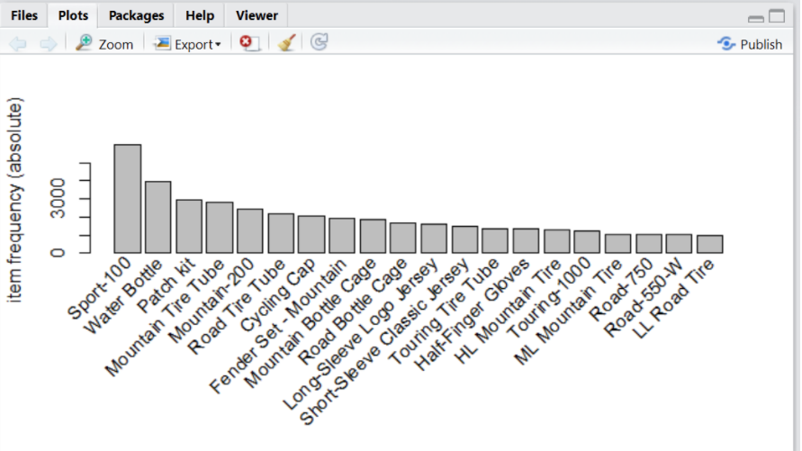
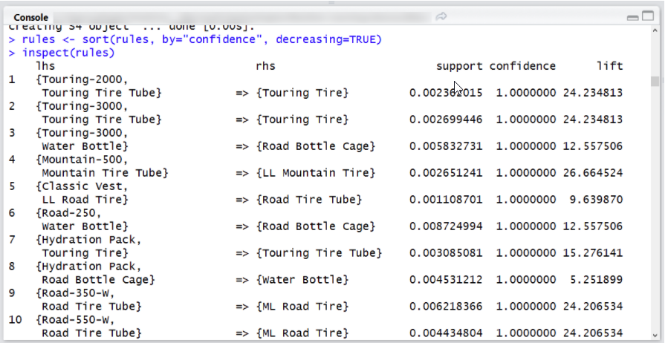
Discovery of RScript
Previous example of problem
Found step by step guide called “Machine Learning (8) - Recommender Engine: Collaborative Filtering” see link.

Slide 3
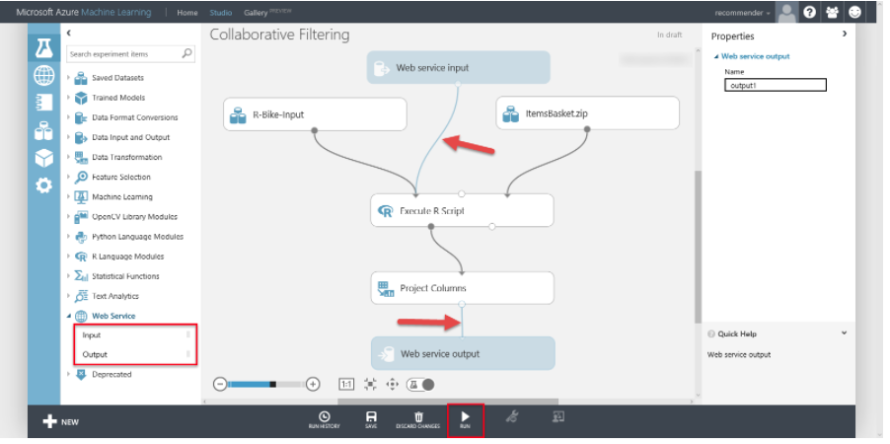
Using script in Azure studios machine learning

Slide 4
Rscripts
What is it?
R is an open source programming language for statistical computing and graphics.
Why use it?
Leading tool for statistics, data analysis and machine learning, allowing for tests and exposed using an public accessible API.
It can be integrated into Machine Learning Studio.
It can be integrated into a C# library using R.net.

Slide 5
Predict the next basket item using statistics.
Dataset
Can be the hardest tasks to get the data. This script required data organised in a matrix form where the 1st column is the orderId and the next columns are the products that where bought.
Item frequency
Total up the frequency of the products added to an order.
Create rules
Compare the frequency against a simulation of items in the basket. This can they provide a basic for the predictions.

